Slide 1


Slide 2
How Value-Based Healthcare Affects Your Practice
Sunil V. Rao, MD, FSCAI
Duke University School of Medicine, Durham, NC
Adhir Shroff, MD, MPH, FSCAI
University of Illinois – Chicago, Chicago, IL

Slide 3
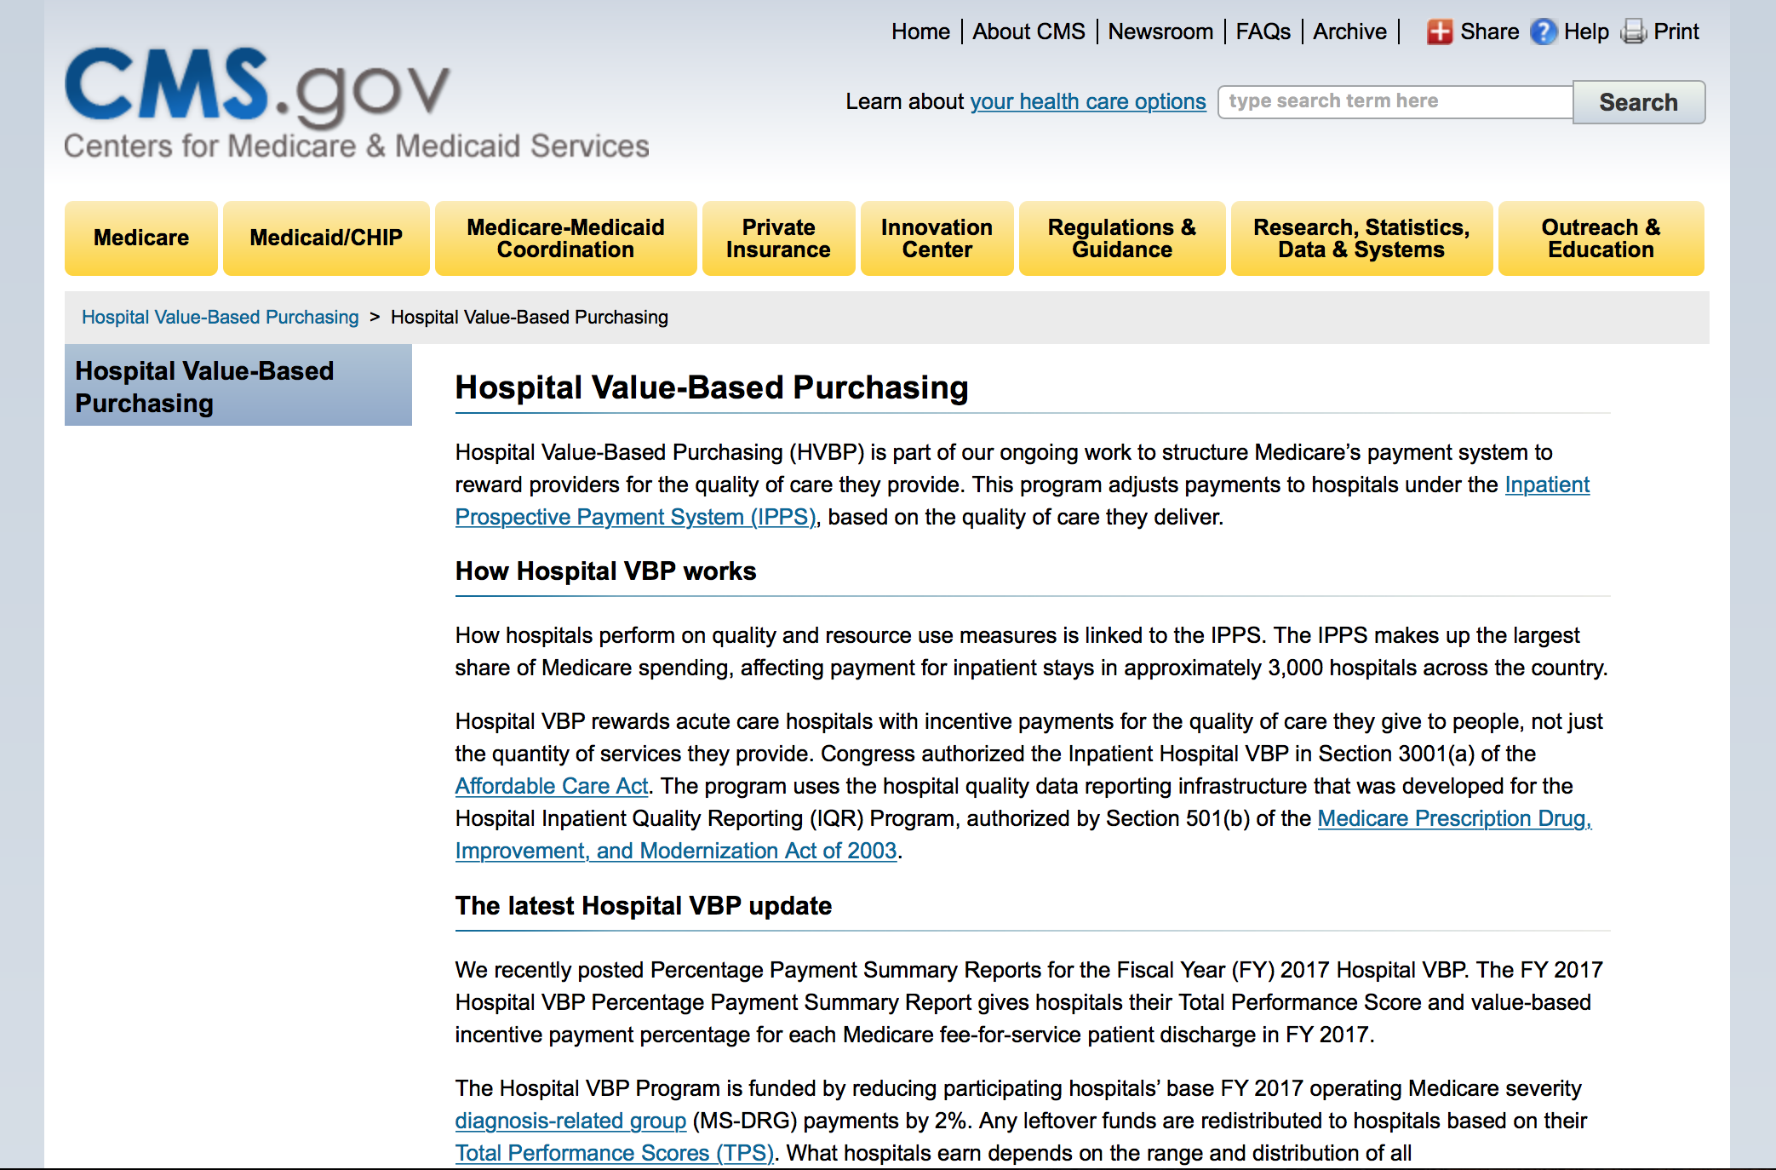

Slide 4
What is “Quality”?
“The degree to which health services for individuals and populations increase the likelihood of desired health outcomes and are consistent with current professional knowledge.”
    - www.iom.edu
  Healthcare outcomes per dollar spent
What is “Value”?
Notes:
So what is quality? Is it like the Supreme Court definition of obscenity? You know it when you see it? Not exactly. There is a specific definition put forward by the IOM. One of the goals of the professional societies is to improve quality of care. The AUC are part of that effort

Slide 5
Performance Measures
Represent a meaningful outcome to patients and society.
Be valid, reliable, and readily measured.
Have the ability to be adjusted for patient variability.
Be modifiable through improvements in care processes.
Be practical to measure.
Quality of Care and Outcomes Research in CVD and Stroke Working Groups. Circulation. 2000;101:1483-1493.
Notes:
Quality of Care
Circulation 2000
P1485
Left column

Slide 6
ACC CathPCI Performance Measures
For internal QI use only
Risk-adjusted PCI In-hospital mortality
  All patients
  STEMI patients
  NSTEMI patients
Risk-adjusted PCI-related bleeding
Risk adjusted Post-PCI AKI
Risk adjusted 30-day readmission after PCI

Slide 7
Bleeding Avoidance Strategies as a Hospital Performance Measure
Adjusted spline plot for %BAS use
on bleeding rates
N~2.4 million PCI pts from CathPCI
Hospitals that use BAS (e.g. radial approach) in ≥ 80% of patients realize bleeding reduction
Vora AN, et. al. JACC Intv 2016

Slide 8
Risks of Hospitalization
Medication errors.
Delerium/falls.
Hospital acquired infections.
Little time for patient education.

Slide 9
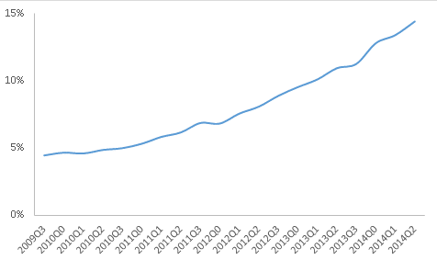
Temporal Changes in SDD for Elective PCI
Data from NCDR
Vora A Circ Intv 2016

Slide 10
Value-based Healthcare
Value in healthcare is an expectation by patients, payers, and regulators.
Quality of care is an integral part of value.
  Bleeding complications are a PCI performance measure.
Adoption of safe, effective, and efficient PCI strategies can achieve value.
  Radial approach.
  Same day discharge in appropriate patients.
The T4V program is designed to facilitate value-based care.

